Slide 1
Itinerary(旅行日程) & Travel Guide

Slide 2
Itinerary
an established line of travel or access
a guidebook for travelers
a proposed route of travel
It includes the advice on what to see and do,
maps, city guides, local transportation, local
customs and festivals, etc

Slide 3
Useful Expressions
1. 每日行程安排：
day by day itineraries
2. 报价包含
price inclusion
3. 报价不含
price exclusion
4. 发车日期
departure date
5. 经济游\豪华游
budget tour\ deluxe tour
6. 住宿
accommodation
7. 淡季\旺季
low season\high season
8. 协议条款\合同条款
terms and conditions

Slide 4
Useful Expressions and Sentence Patterns
旅游景点介绍，如历史文化背景， 特产等
1.本次旅程将带您到中国的一些偏远地区。
This tour takes you to the very remote parts
of China.
2.这是中国传统文化的象征。
That is the symbol of traditional Chinese
culture.
3.本次文化之旅的亮点是去探索有千年历史的南浔
古镇。
The highlight of this culture travel route is to
explore the Ancient Town of Nan Xun.

Slide 5
每日行程安排及所包含服务项目
4.报价包含：全程独立旅游车交通费、门票及导游费用。
The price includes all transfer with private vehicle, entrance fees and tour guide.
5.以上报价基于至少两位游客，单个游客请再付95美元，六人以上游客请发e-mail给我们以咨询新的报价。
The price above is based on minimum two travelers. For single person, please pay extra $95. For a group of over 6 people, please email us for a new quotation.
6.提前付款
Payment in advance.

Slide 6
7. 导游将在机场接你们，然后到酒店。
You are greeted by your guide at the airport and transferred to the hotel.
8.优惠条款：八人以上打八折。
Bonuses info: 20% off for a group of 8 people and above.

Slide 7
 | Destination | Accommodation | Free services and possible charges
Day 1 | England | / | Free meal, drinks, and in-flight entertainment
Day 2 | London | Central Park Hotel | Breakfast. An optional transfer $ 42 ( or from London Gatwick $ 53)
Day 3 | London | Central Park Hotel | Breakfast. Shakespeare's Globe Theatre ($67) Wallace Plaque

Slide 8
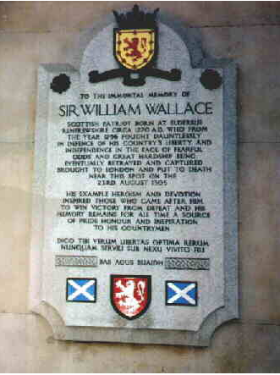

William Wallace was a Scottish knight who became one of the main leaders during the Wars of Scottish Independence. He is the hero of the movie Braveheart .

Slide 9
Day 4 | Netherlands | NH Central Station | Breakfast. Optional transfer for $42 ($53 to Gatwick) for your flight to Amsterdam. A Transfer from the airport to your hotel is available for $41
Day 5 | Amsterdam | NH Central Station | Breakfast. Historic homes, 16th-century warehouse and churches ($31)
Day 6 | Amsterdam | NH Central Station | Breakfast. Visit a cheese farm before returning through the countryside to Amsterdam ($36)
Day 7 | U.S.A | / | Breakfast. Optional transfer ($$41)

Slide 10
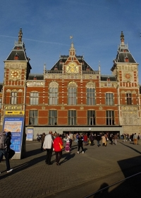
NH Central Station

Slide 11
Date | Sites | Stay at | Travel by
2017.7.15 | Hangzhou-Vancouver 11:05- 11:10Vancouver -Ottawa | Courtyard Ottawa East 200 Coventry Road, K1K 4S3 Ottawa | Flight CA 1510/991
7.15-7.17 | Ottawa | Courtyard Ottawa East 200 Coventry Road, K1K 4S3 Ottawa | car
7.18 | Ottawa-2h-Kingston | Residence Inn by Marriott Kingston Water's Edge 7 Earl Street,Kingston , K7L 0A4 | car
7.19 | Kingston-2.5h-Toronto-1.5h-Nigara Fall | Hilton Hotel and Suites Niagara Falls/Fallsview 6361 Fallsview BoulevardNiagara Falls, L2G 3V9 | car
7.20 | Toronto | Residence Inn by Marriott Toronto Airport 17 Reading Court Etobicoke Toronto , M9W 7K7 | car
7.21 | Toronto-CalgaryCrossIron Mills shopping | Lakeview Signature Inn 2622 39th Avenue Northeast, T1Y 7J9 14037353336 | Flight
7.22-7.24 | Calgary-1A-(Canmore)-banff-Lake louise | Lake Louise Inn 210 Village Road PO BOX 209, Lake Louise, T0L 1E0 | car
7.25 | Lake Louise-(232km)3h-Jasper | Dave & Honey's Accommodation 804 Turret Street, T0E 1E0 ，Jasper 1780852727 | car
7.26 | Jasper-(321km)4h- Golden | Kapristo Lodge 1297 Campbell Road, V0A 1H7 12503446048 | car
7.27 | Golden-Vancouver | Robson Suites 777 Bidwell Street, V6G 3B9 +16046859777 | car
7.28-8.1 | Vancouver | Robson Suites 777 Bidwell Street, V6G 3B9 +16046859777 | car
8.2 | Vancouver-Hangzhou10:40-18:30 |  | FlightCA998/1563

Slide 12
Homework: Write a tourists’ guide by translating the following information.
北京豪华3日游 报价：RMB 2800
出发时间：每天
行程安排：第一天：天坛---天安门广场---故宫---北海
第二天：颐和园---圆明园
第三天：长城---十三陵
报价包含服务：
1. 免费从机场、车站接送至酒店，以及全程景点的旅游车接送服务
2. 5星级住宿
3. 一日三餐
4. 所有门票

Slide 13
Luxury Tour 3 Days of Beijing
Quotation: 2800
Departure Time: Daily
Day by day itineraries:
Day 1 Temple of Heaven-Tian’anmen Square-The Imperial Palace-Beihai Park
Day 2 Summer Palace-Yuan Ming Yuan Garden
Day 3 Great Wall-Ming Tombs
Price Inclusion:
Free transfer from the airport and stations to the hotel and to all scenery spots with private van
Accommodation: 5 star hotels
Three meals a day

Slide 14
Preparation
www.baidu.com
www.wikipedia.org
www.mafengwo.cn
www.eueueu.com

Slide 15
Booking
www.qunaer.com
www.skyscanner.com
www.airasia.com
www.airasiago.com

Slide 16
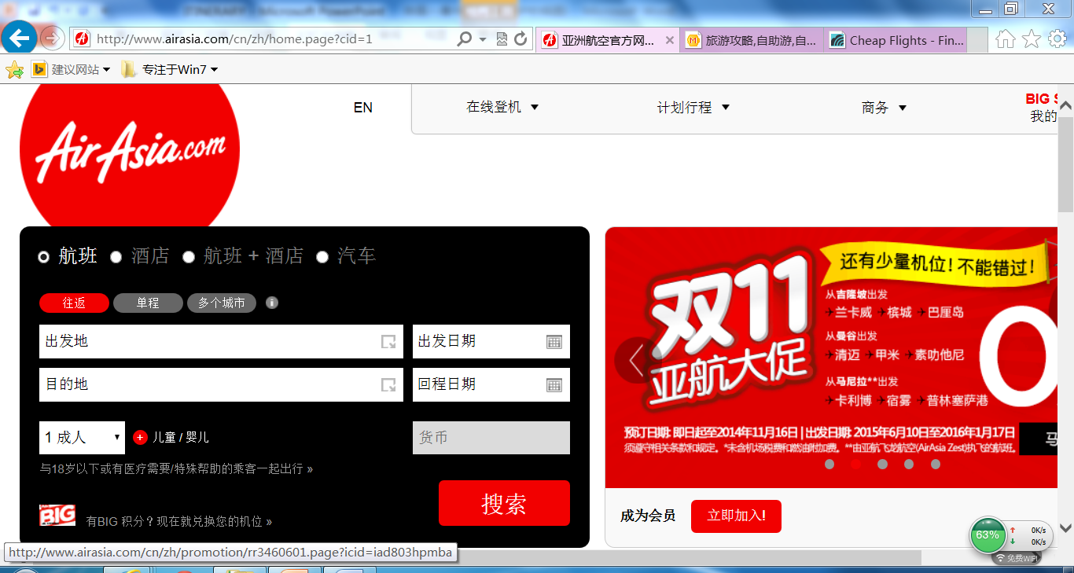
www.airasia.com

Slide 17

www.airasiago.com

Slide 18
Booking
www.ctrip.com
www.agoda.com
www.booking.com

Slide 19
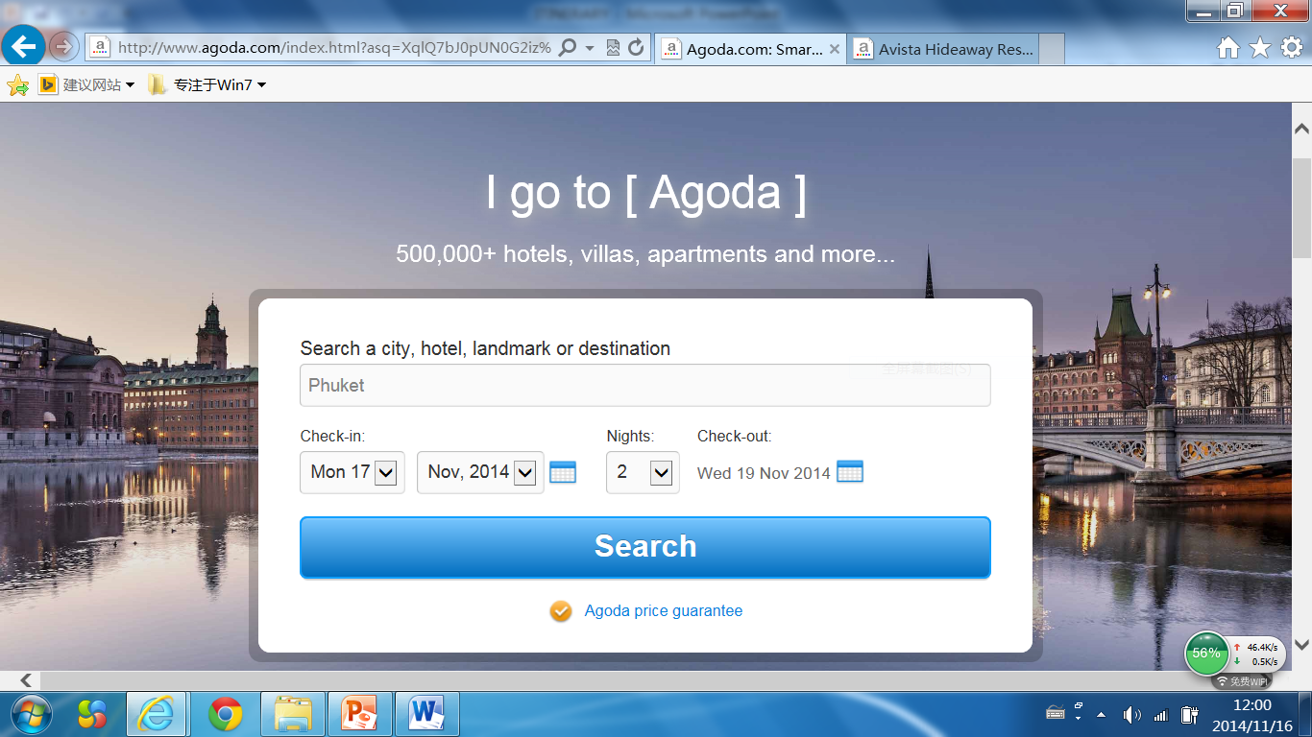
www.agoda.com

Slide 20
Getting Ready to Go
Passport
Visa
Arrival/Departure Card
Customs Declaration Form

Slide 21
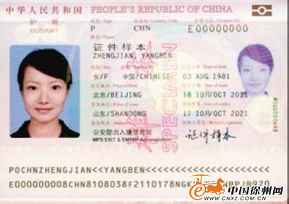
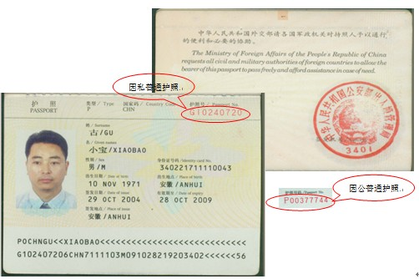

Slide 22
Arrival Card
1. Family Name 姓
2. First (Given) Name 名 |  |  |  |  |  |  |  |  |  |  |  |  | 3. Birth Date (day/mo/yr) 出生日期（日/月/年）
4. Country of Citizenship 国籍 |  |  |  |  |  |  |  |  |  |  |  |  | 5.Sex (Male or Female) 性别（男或女）
6.Passport Number 护照号 |  |  |  |  |  |  |  |  |  |  |  |  | 7.Airline and Flight Number 航班号NumberHANG航班号
8.Country Where You Live居住的国家 |  |  |  |  |  |  |  |  |  | 9.City Where You Boarded居住的城市
10.City Where Visa Was Issued获得签证的城市 |  |  |  |  |  |  |  |  |  |  |  |  | 11.Date Issued (day/mo/yr) 签证日期（日/月/年）
12.Address While in the United States (Number and Street)在美地址（含街道和门牌号）
13.City and State（上述地址所在）城市和州

Slide 23
Departure Card
1. Family Name 姓
2. First (Gicen) Name 名 |  |  |  |  |  |  |  |  |  |  |  |  |  |  |  |  |  |  |  |  | 3. Birth Date (day/mo/yr) 出生日期（日/月/年）
4. Country of Citizenship 国籍

Slide 24
Arrival Card and Customs Declaration

Slide 25
Arrival card of some other countries

Slide 26
Groupwork
Pick a destination.
Write an itinerary.
Make up your travel story to provide more information, e.g. passport etc.
Exchange your stories and fill in the forms.

